Slide 1
UNIT II
Nature and style of Sensible writing
Principles of Formal writing
Building introduction, key points and conclusion
Importance of proper Punctuation
Usages of connectives
Precise writing
Essay writing
Words commonly confused/ misused

Slide 2
Principles of Formal writing

Slide 3
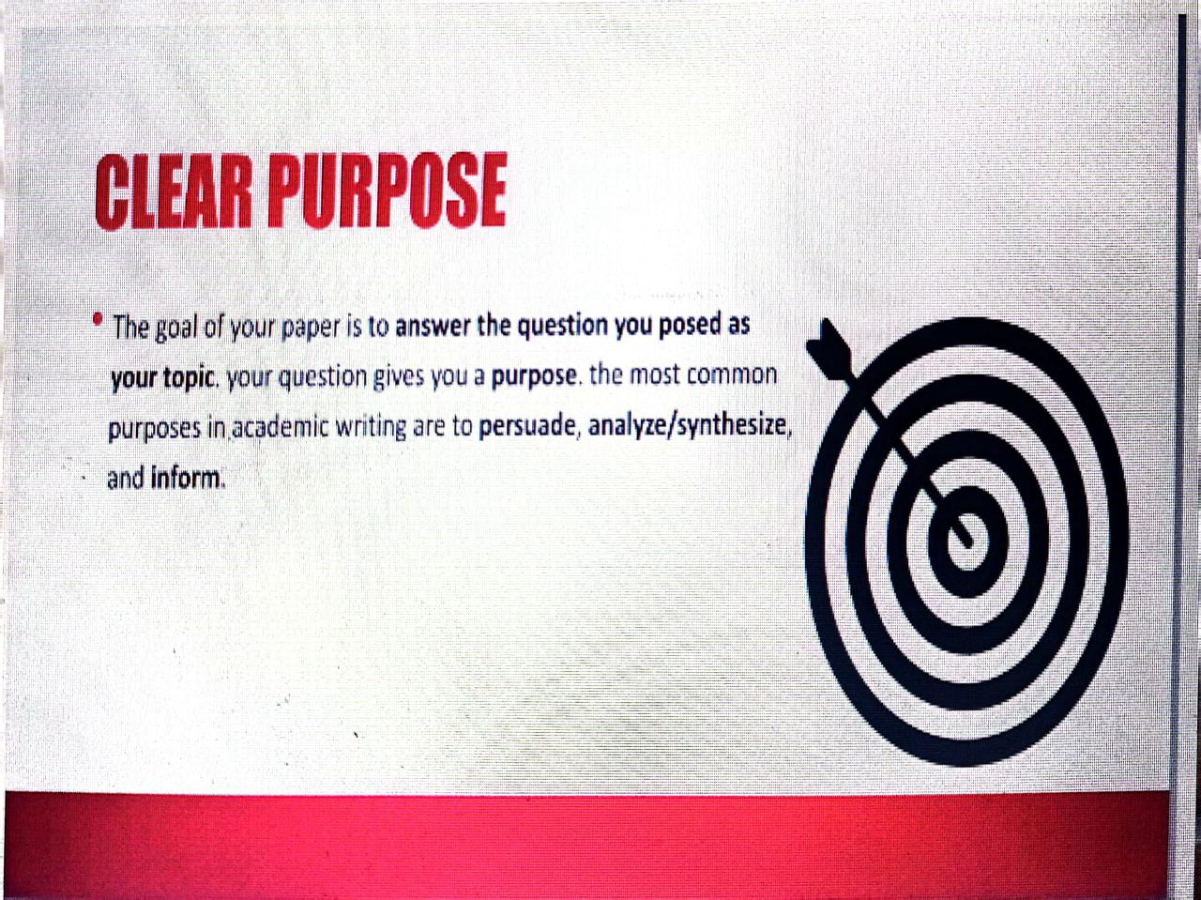

Slide 4
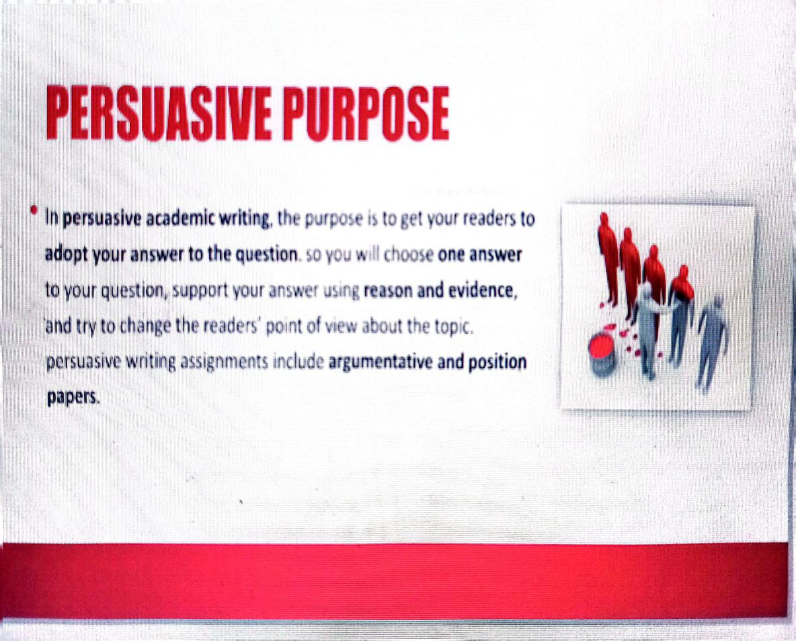

Slide 5
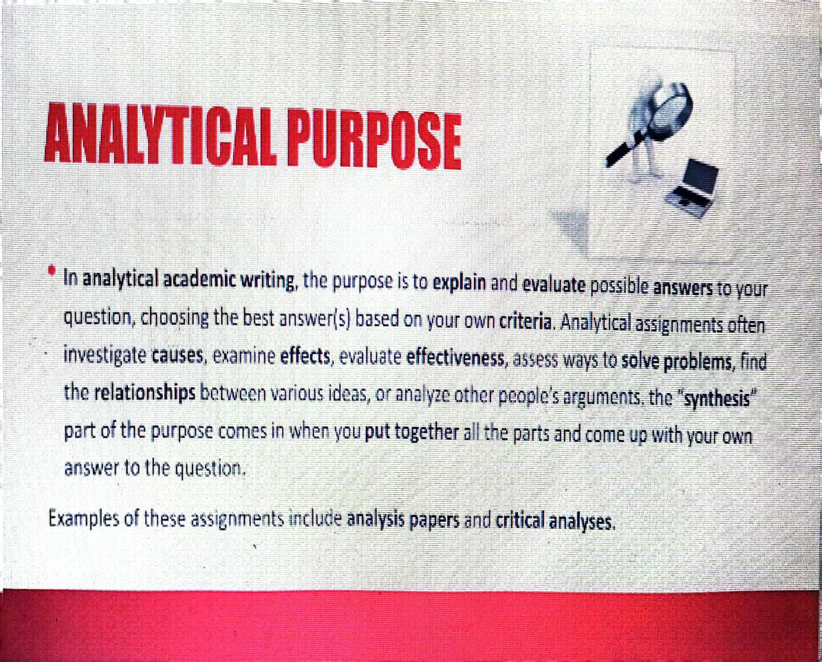

Slide 6
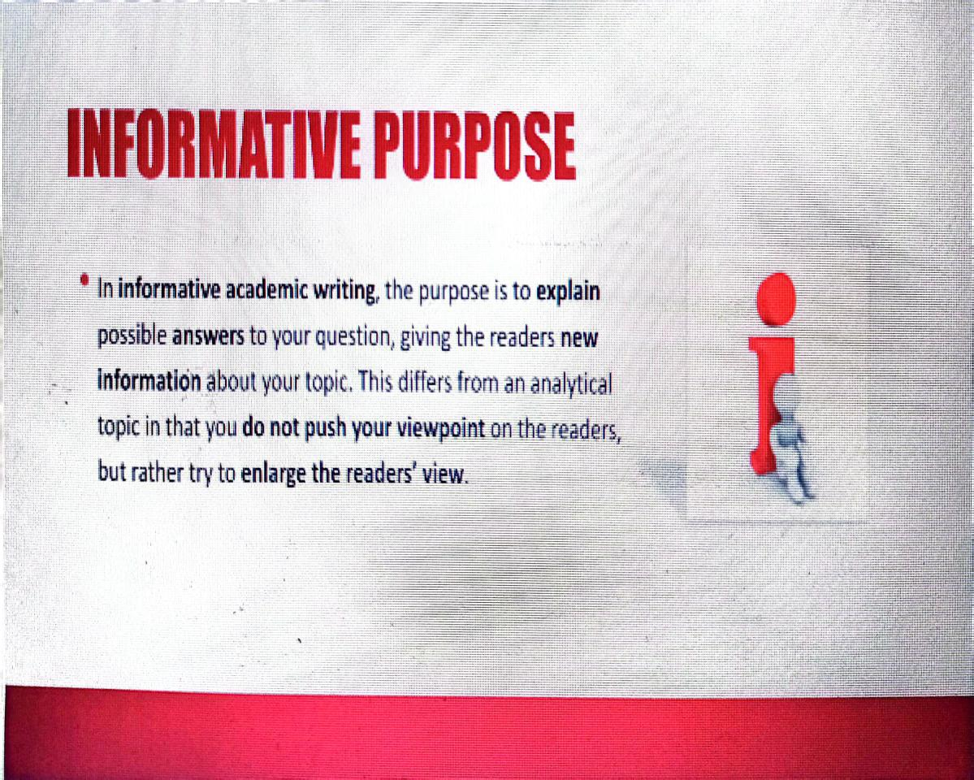

Slide 7
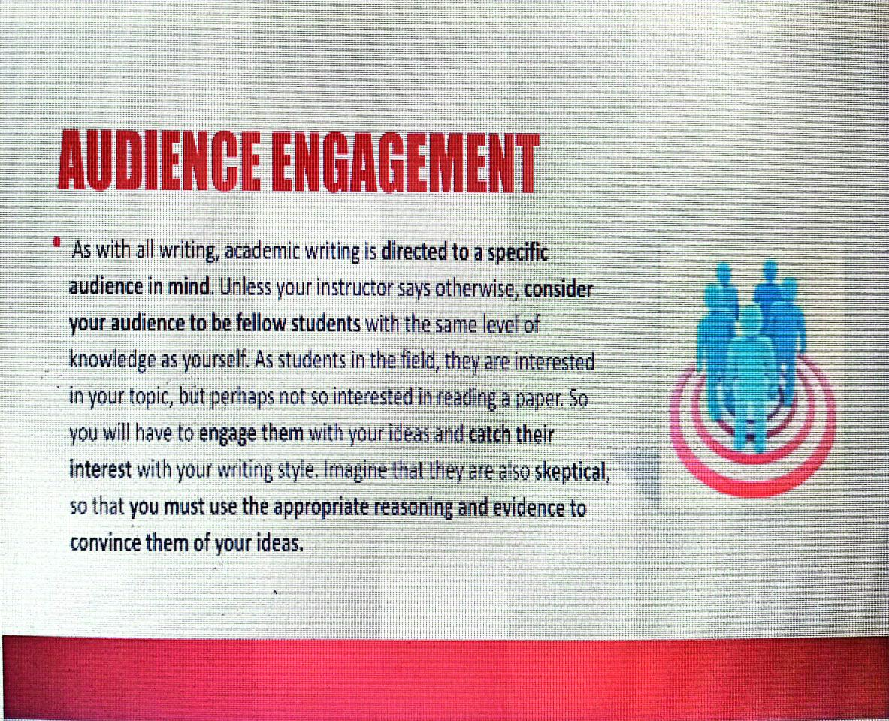

Slide 8
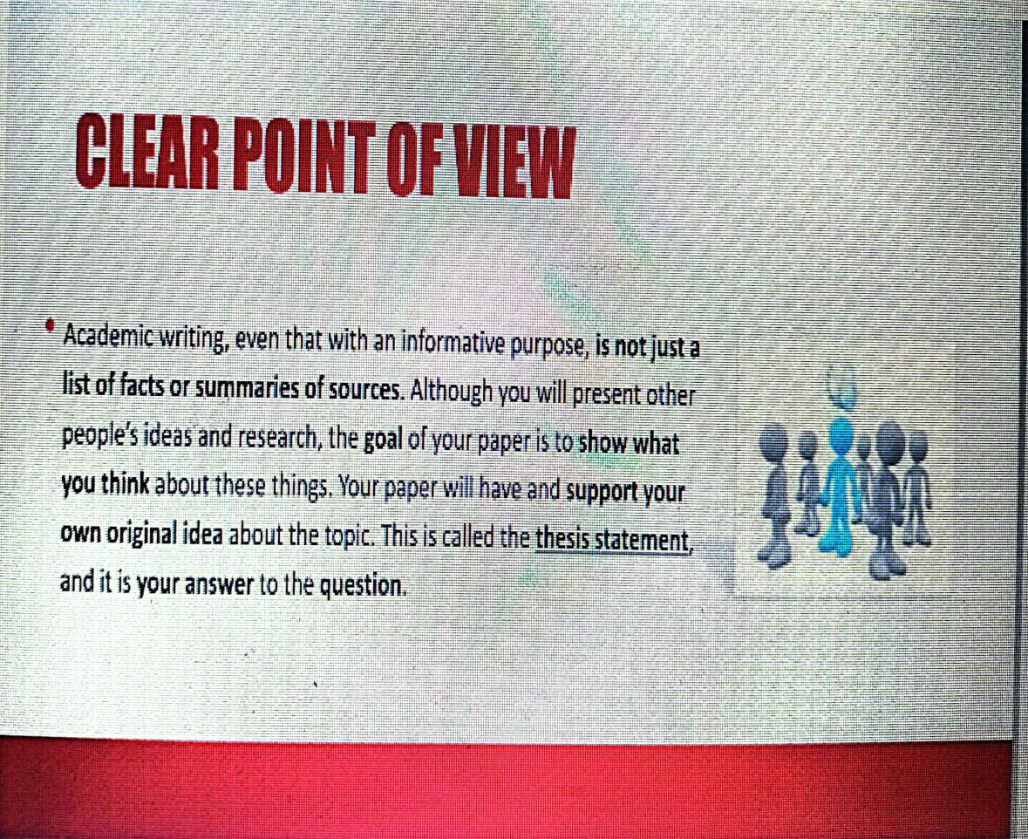

Slide 9
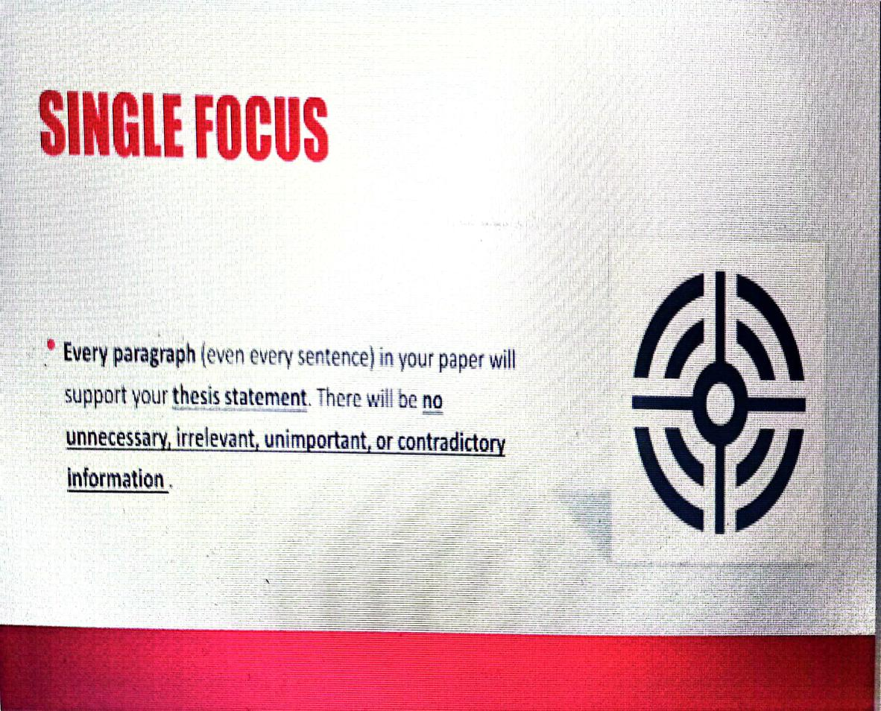

Slide 10
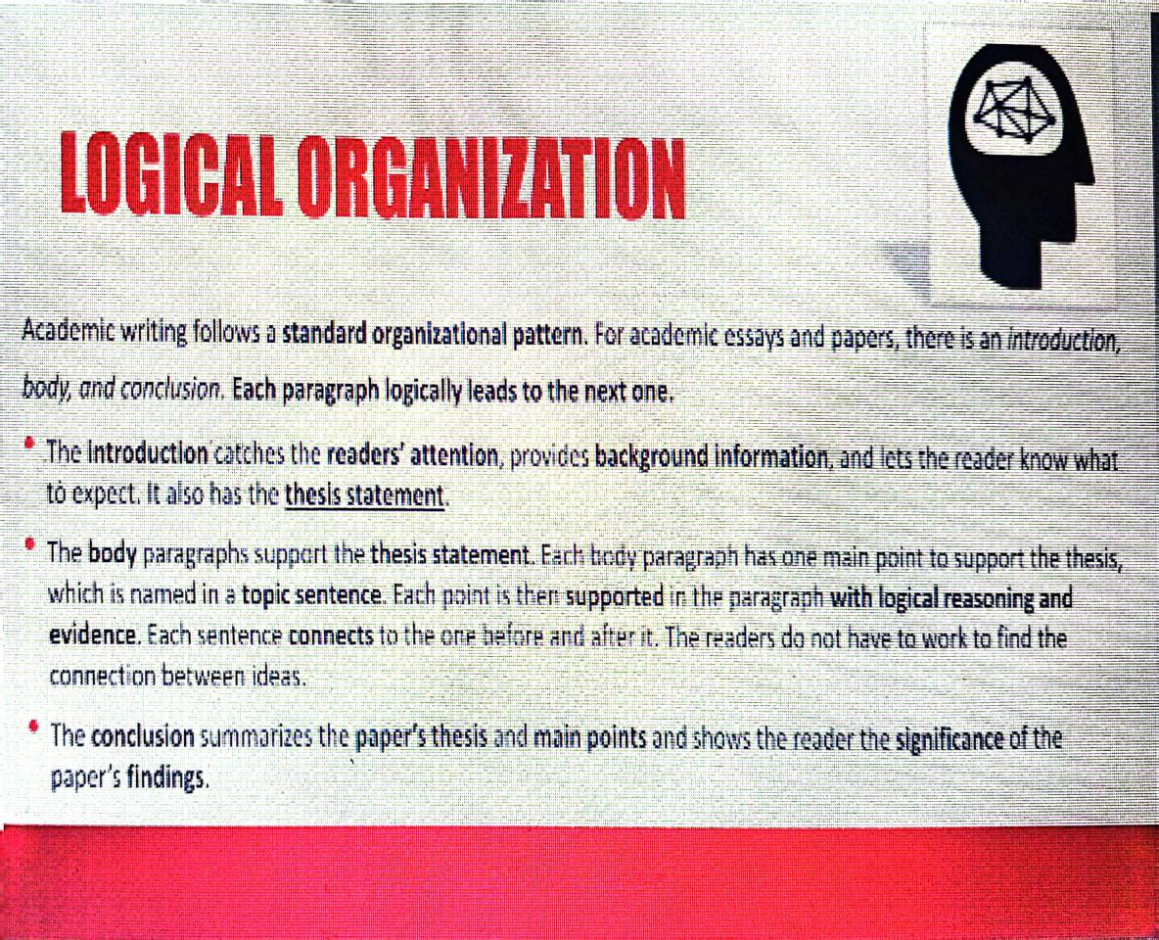

Slide 11
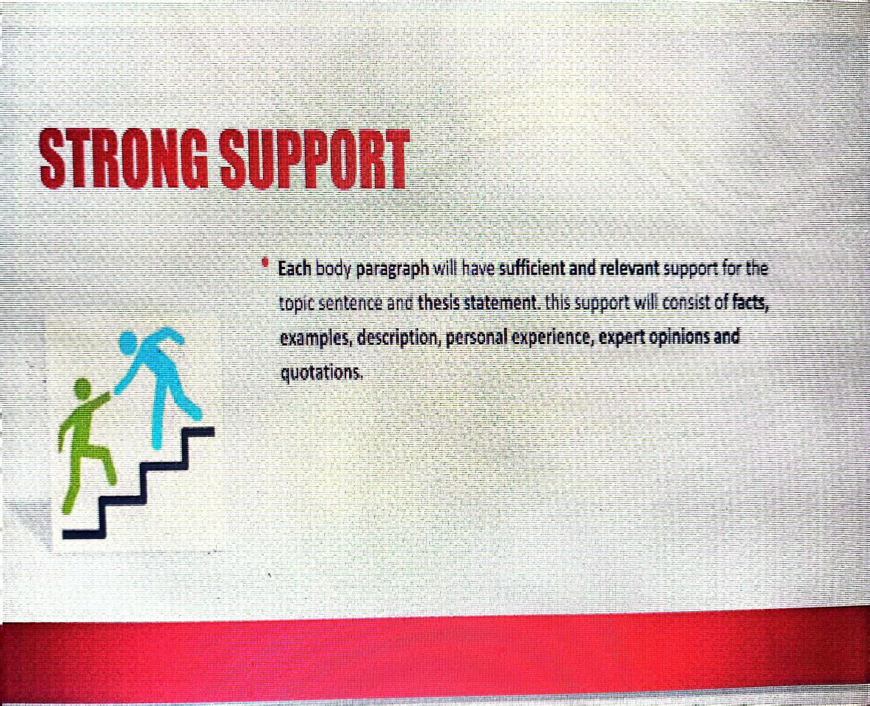

Slide 12
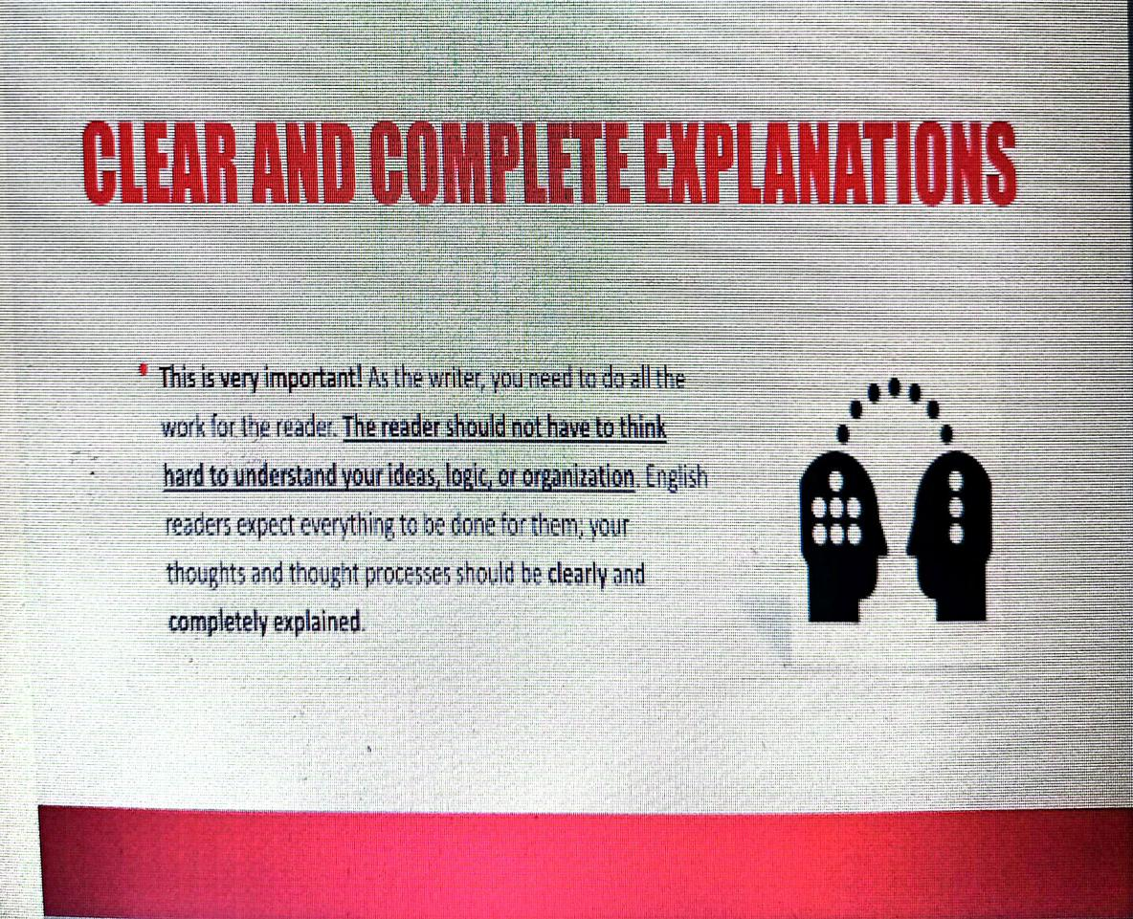

Slide 13


Slide 14
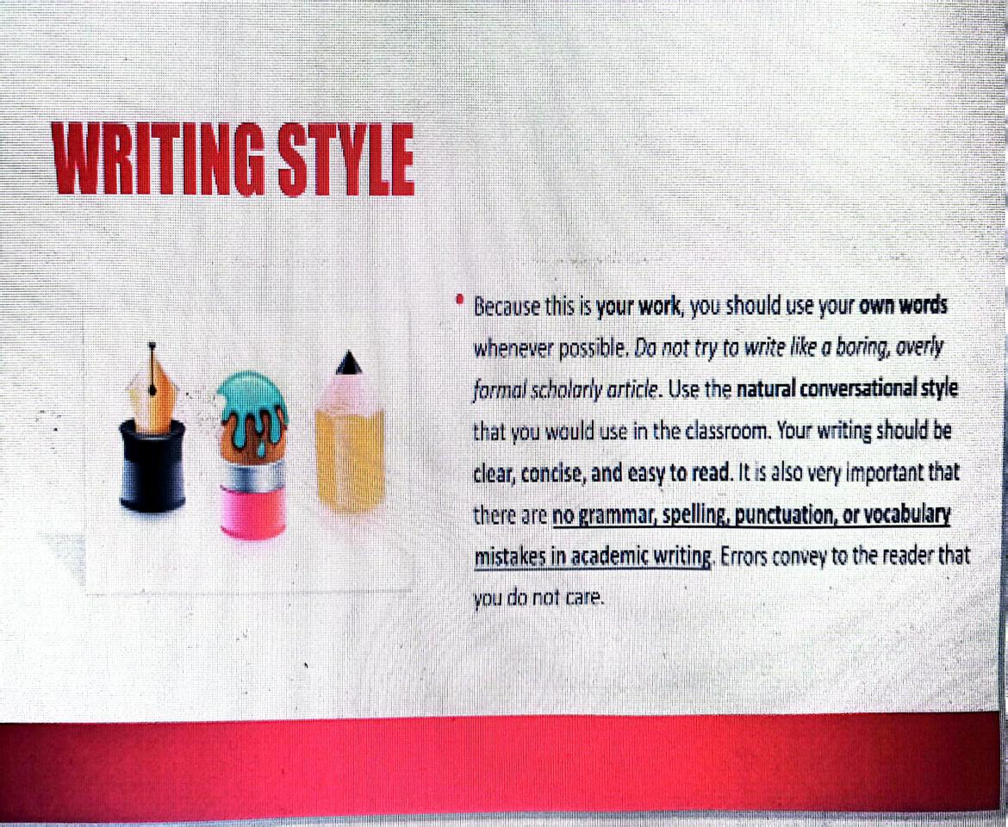

Slide 15
Importance of proper Punctuation

Slide 16
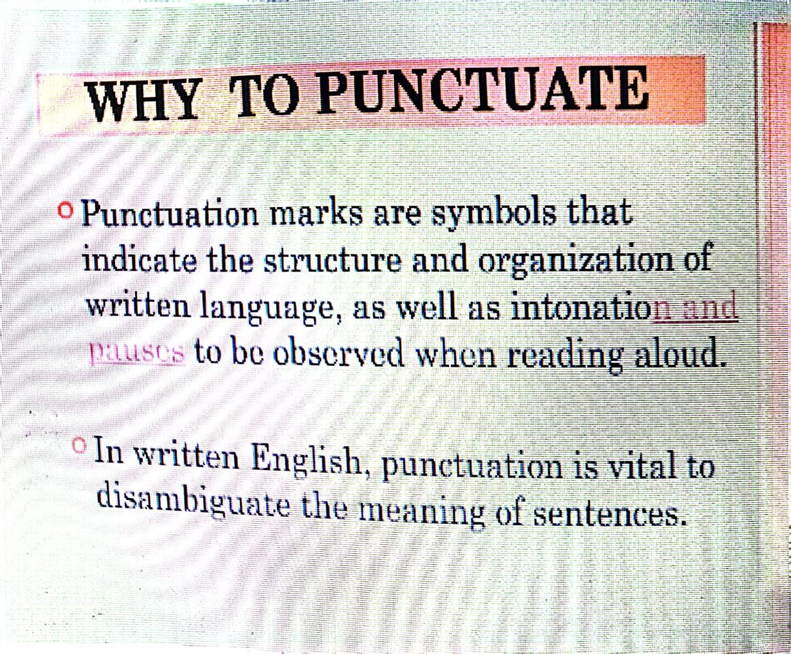

Slide 17
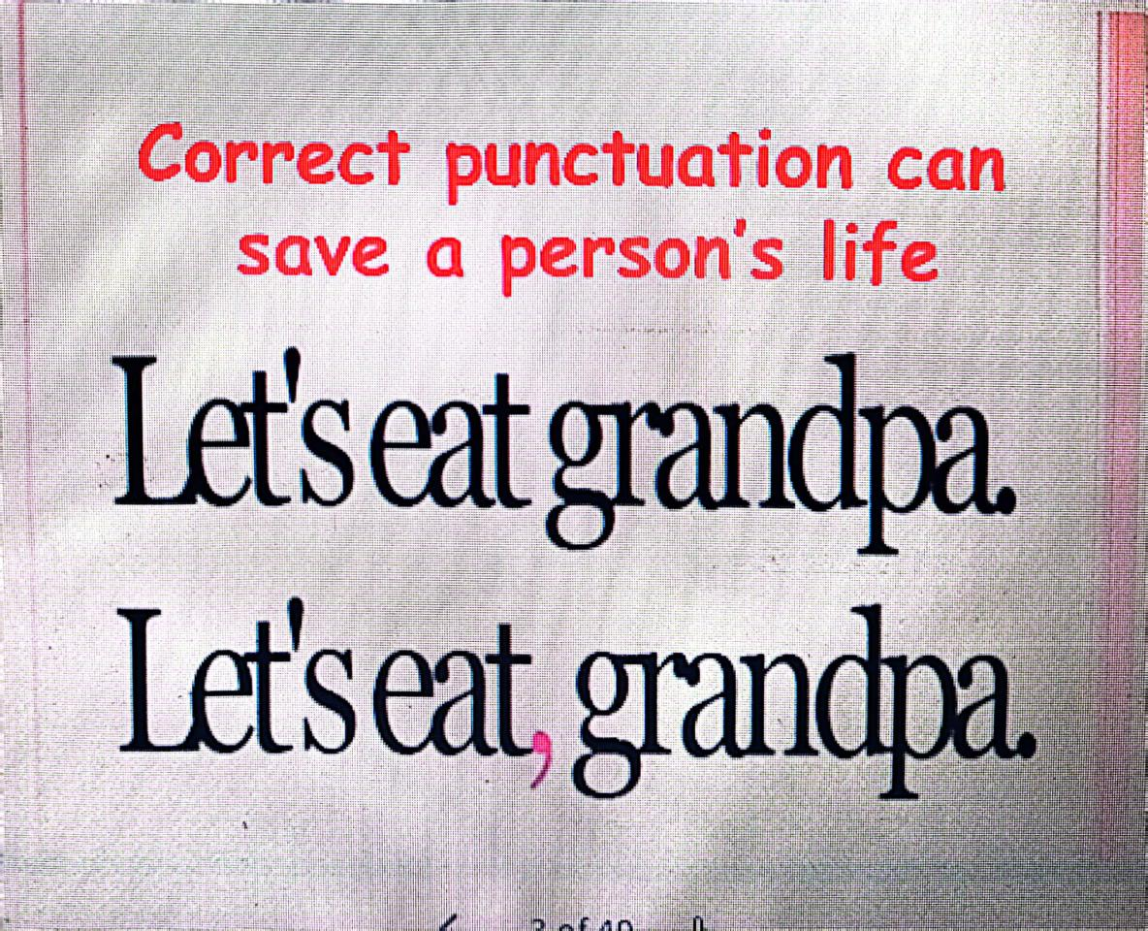

Slide 18
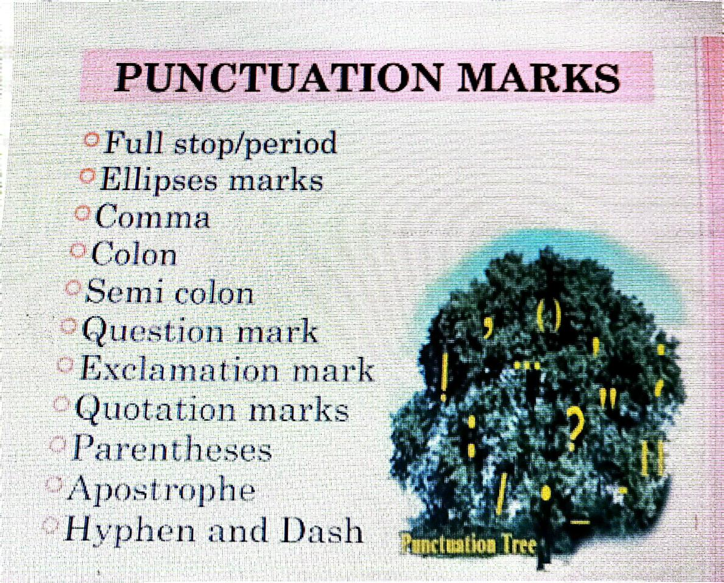

Slide 19
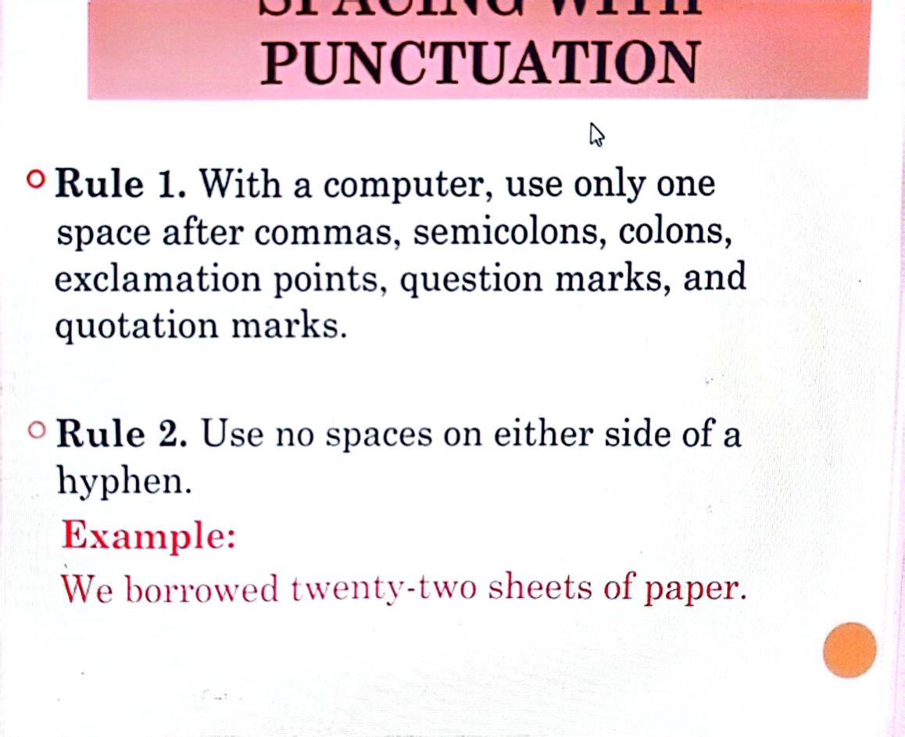

Slide 20
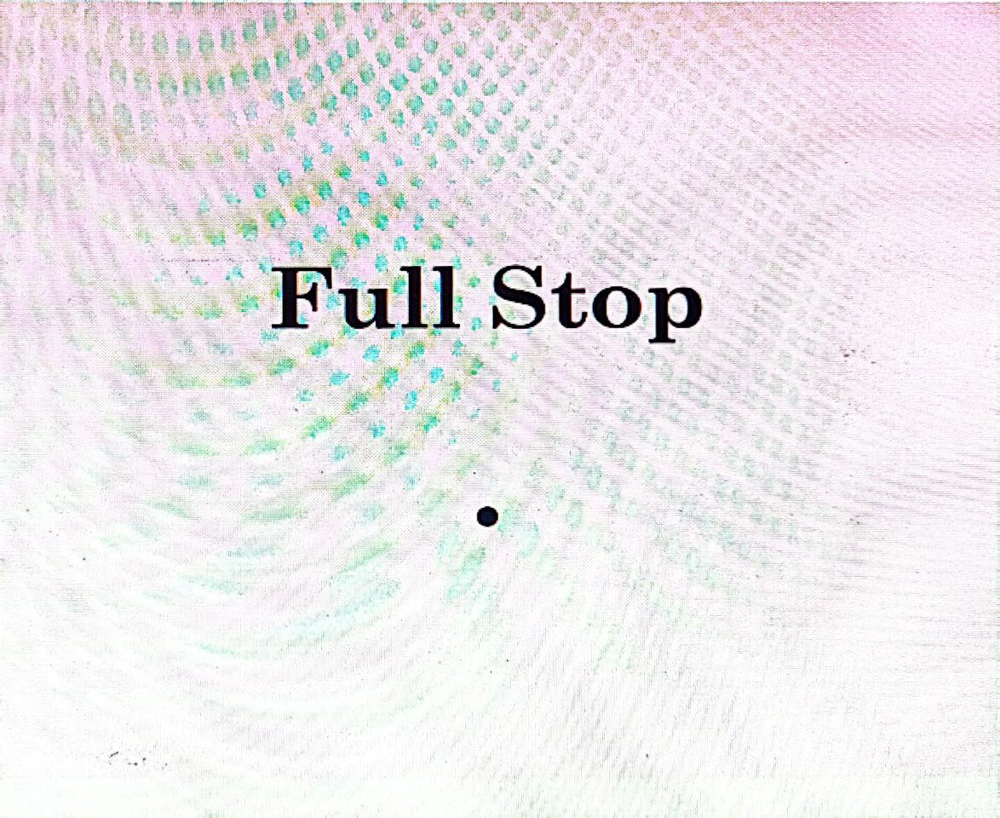

Slide 21
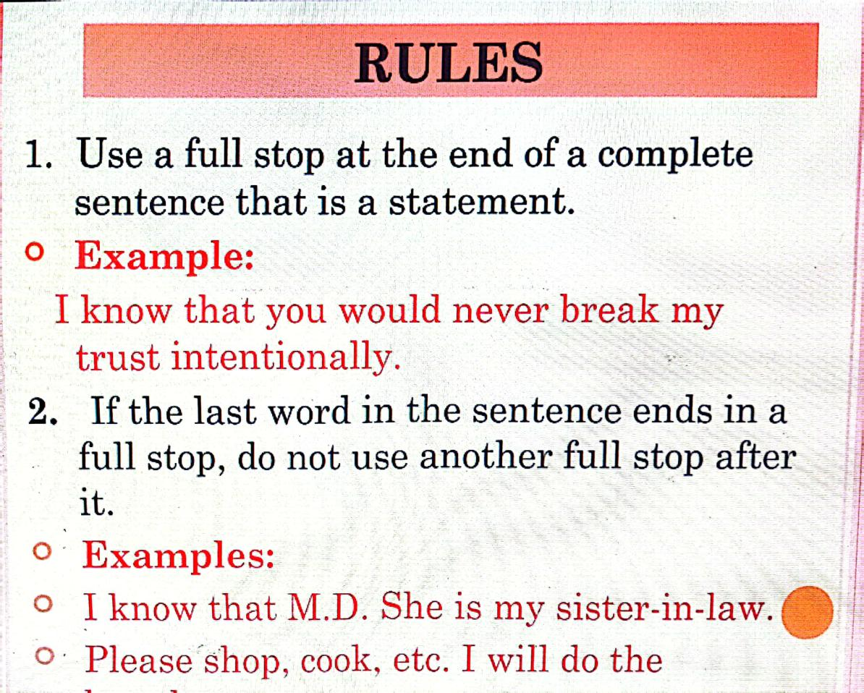

Slide 22
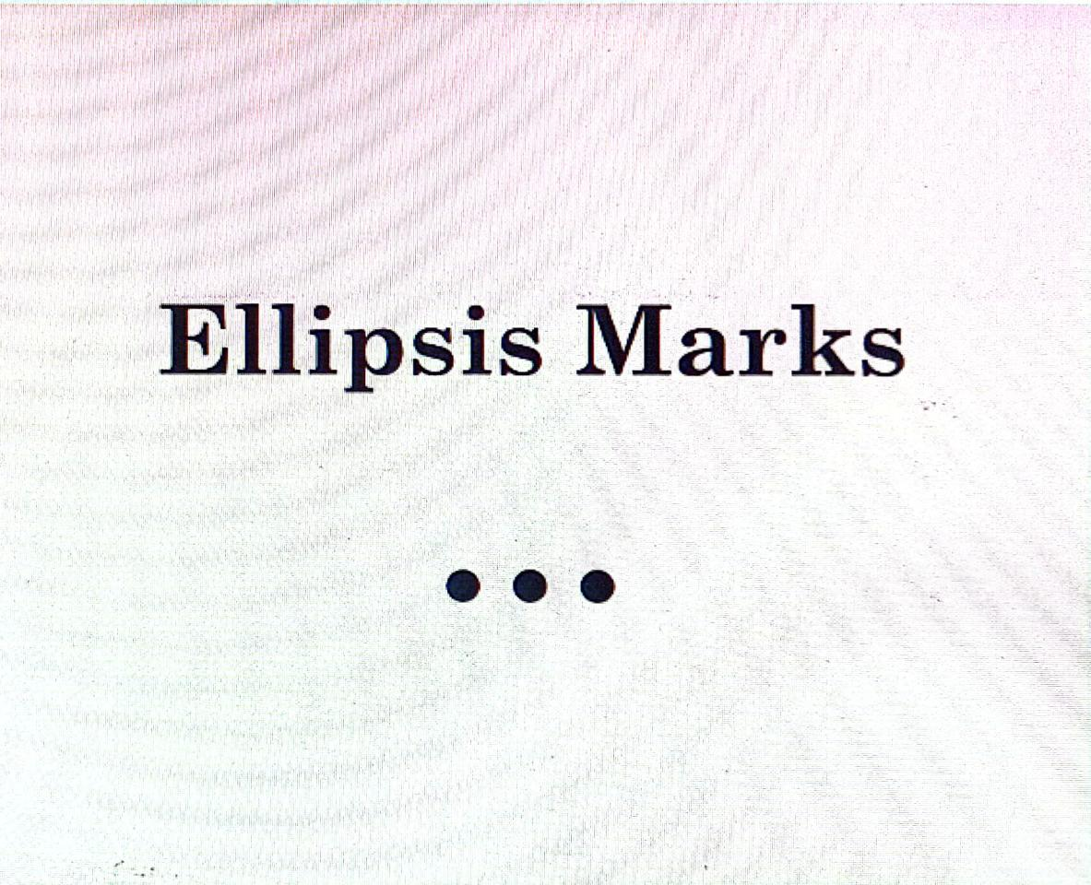

Slide 23
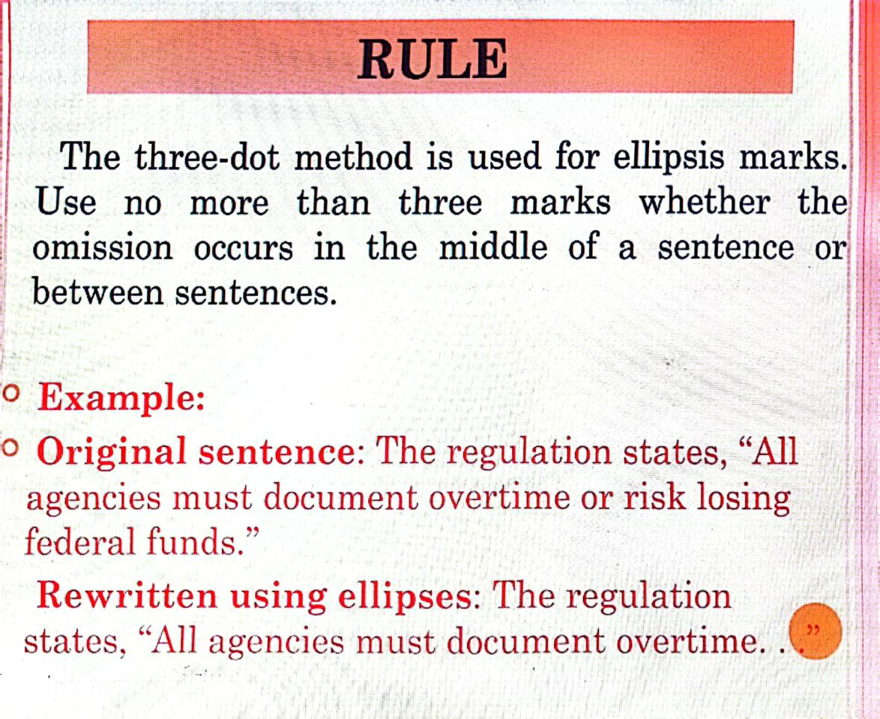

Slide 24
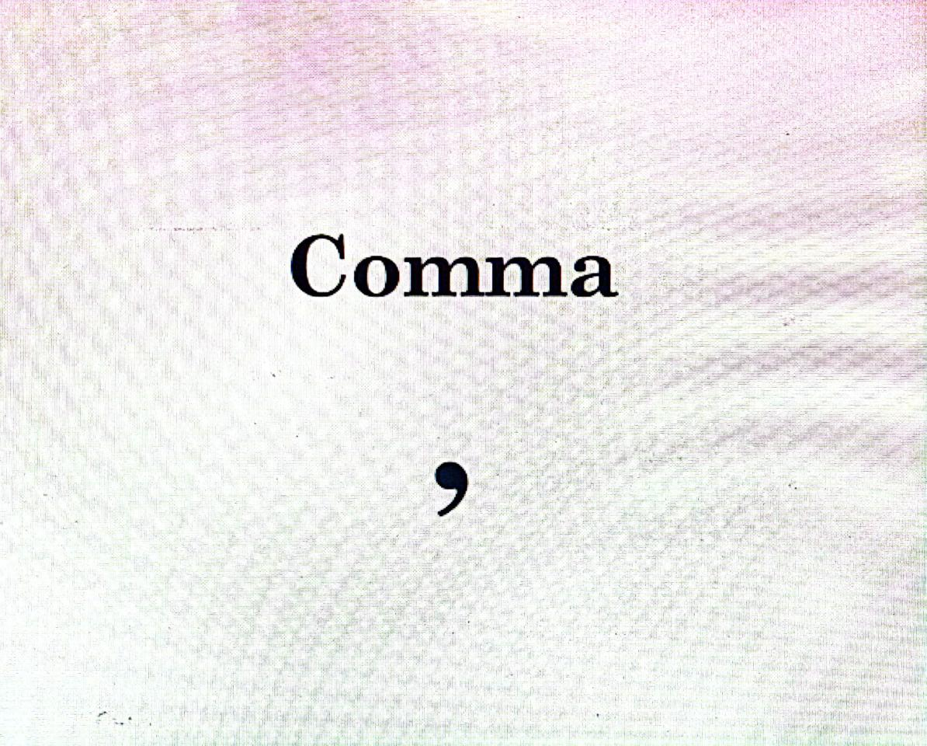

Slide 25
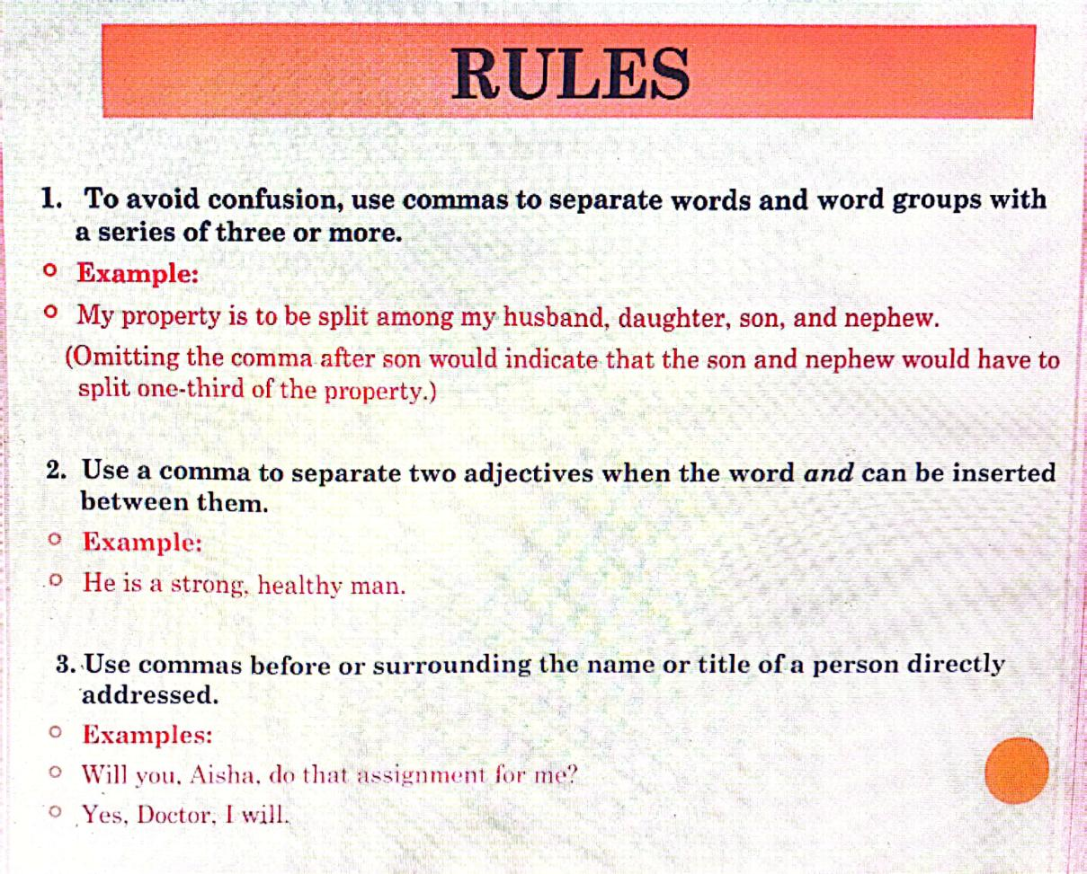

Slide 26
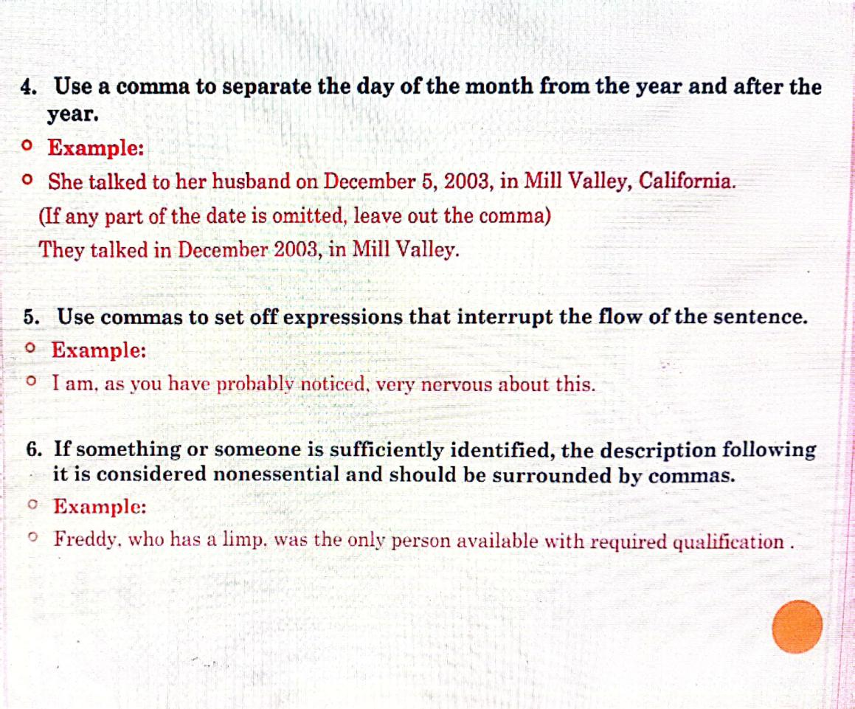

Slide 27
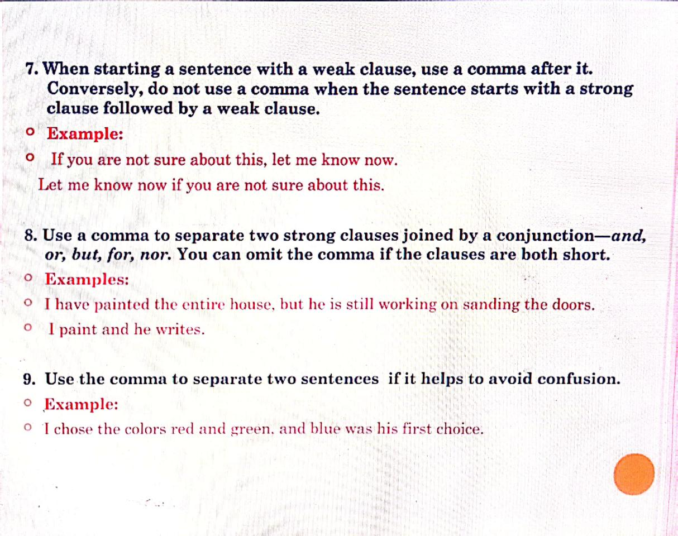

Slide 28
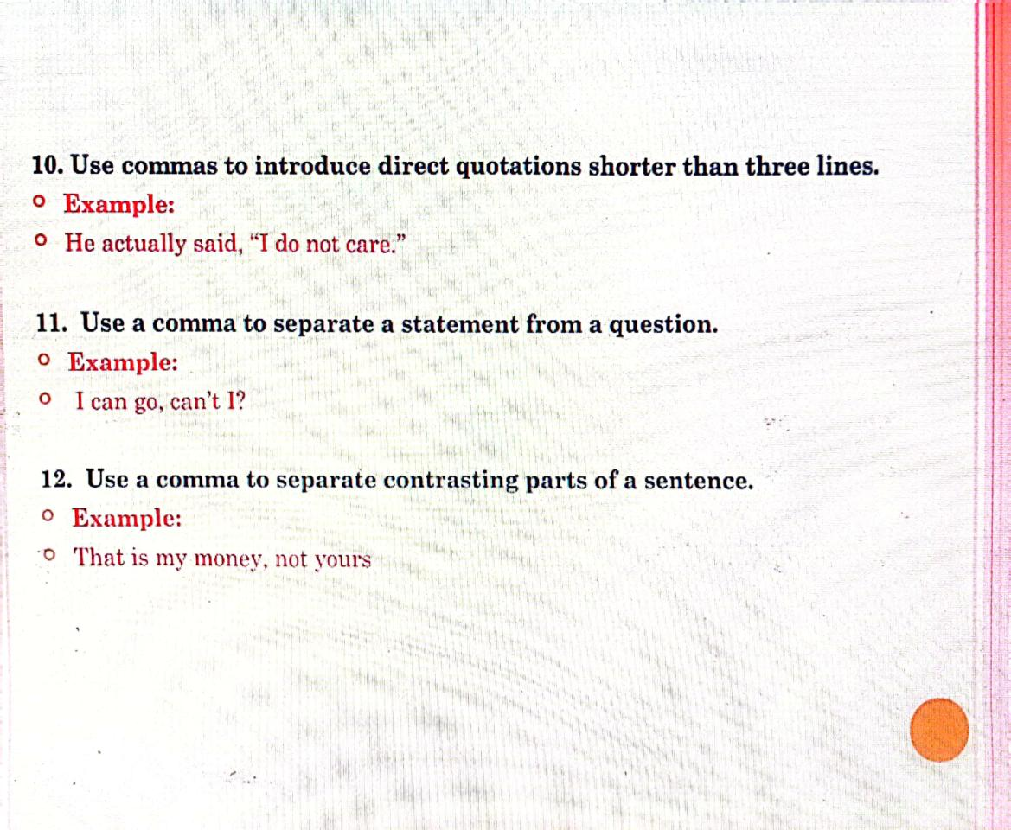

Slide 29
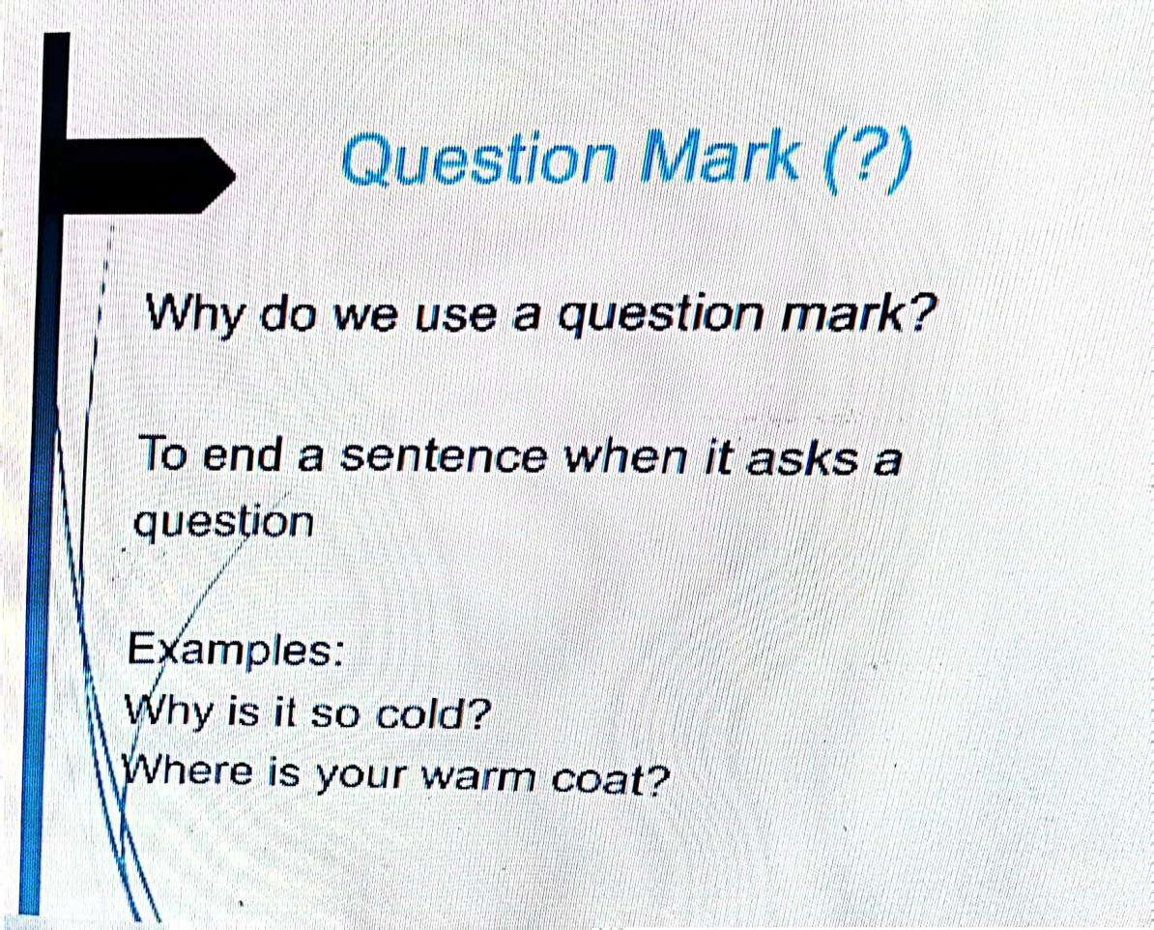

Slide 30
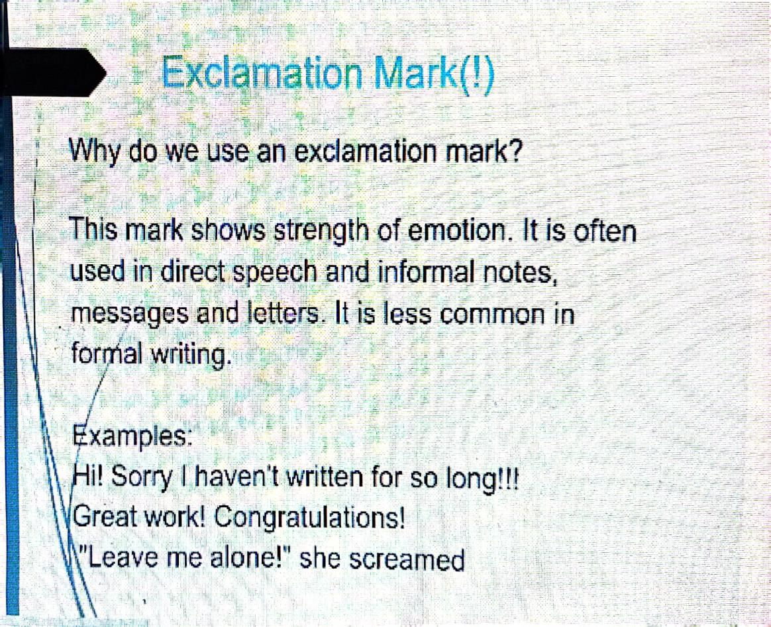

Slide 31
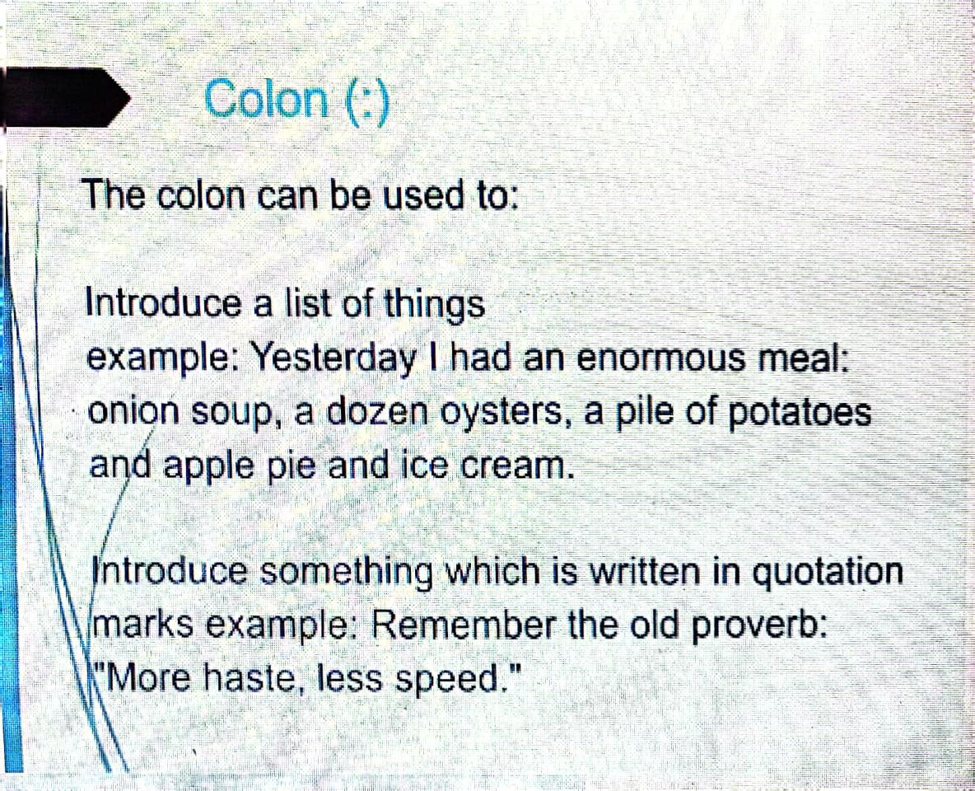

Slide 32
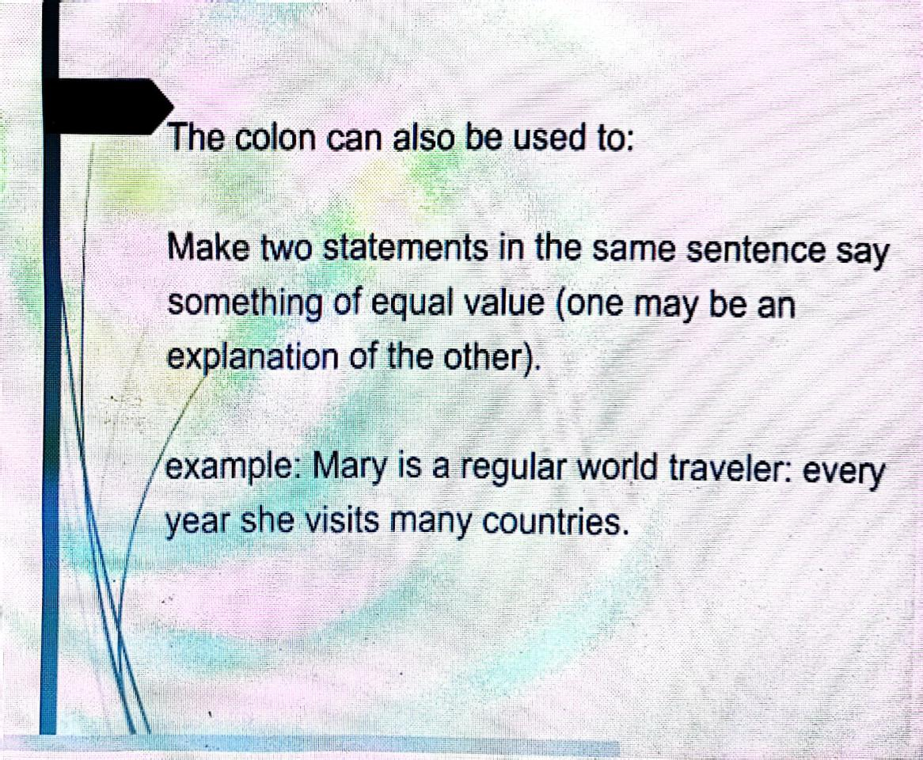

Slide 33
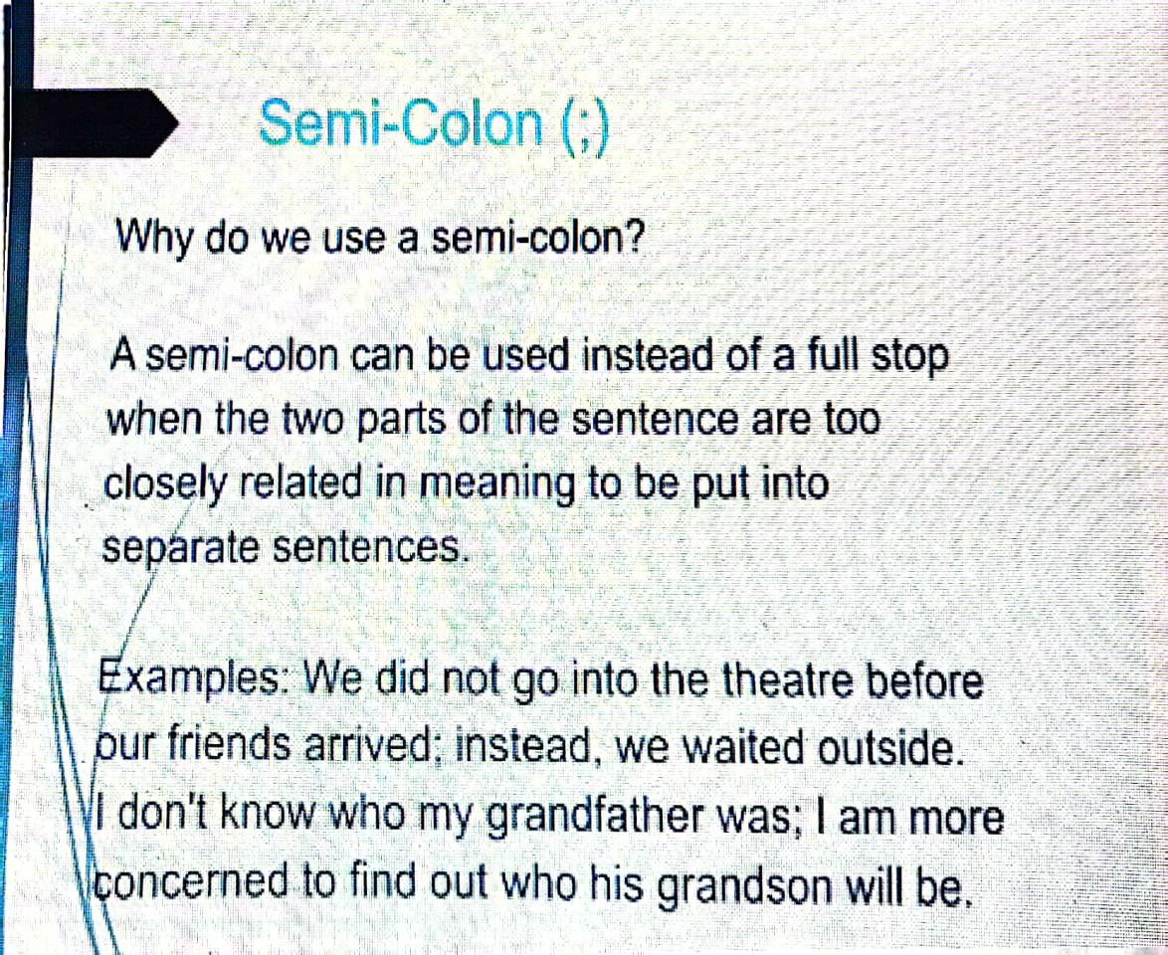

Slide 34
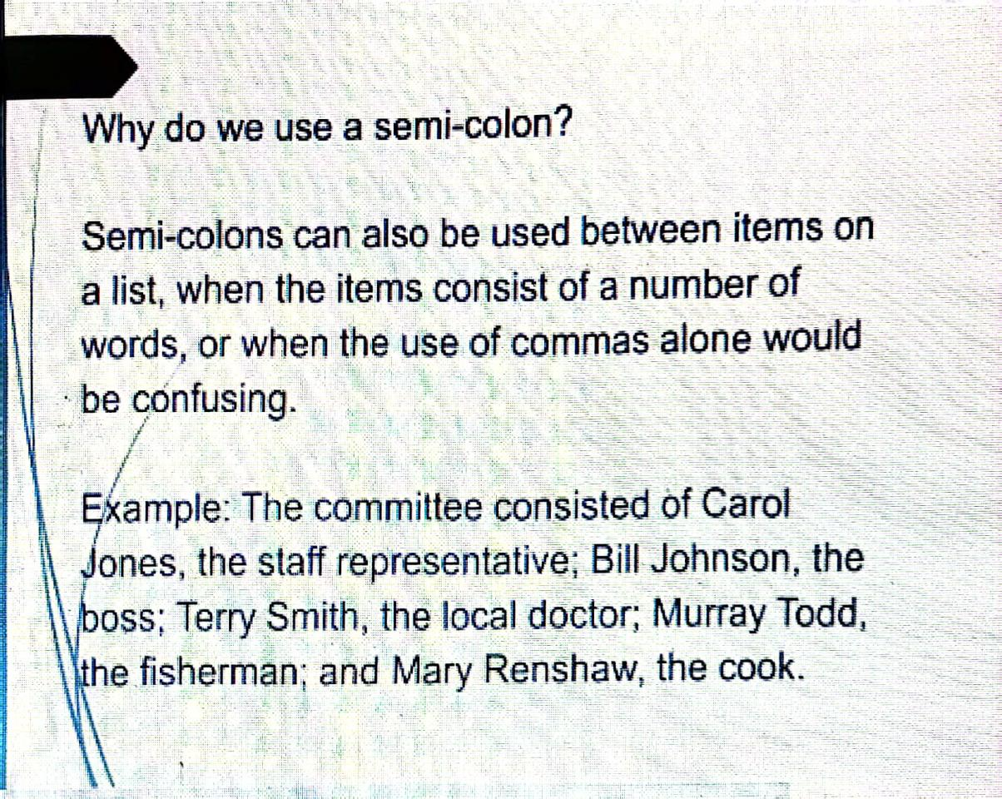

Slide 35
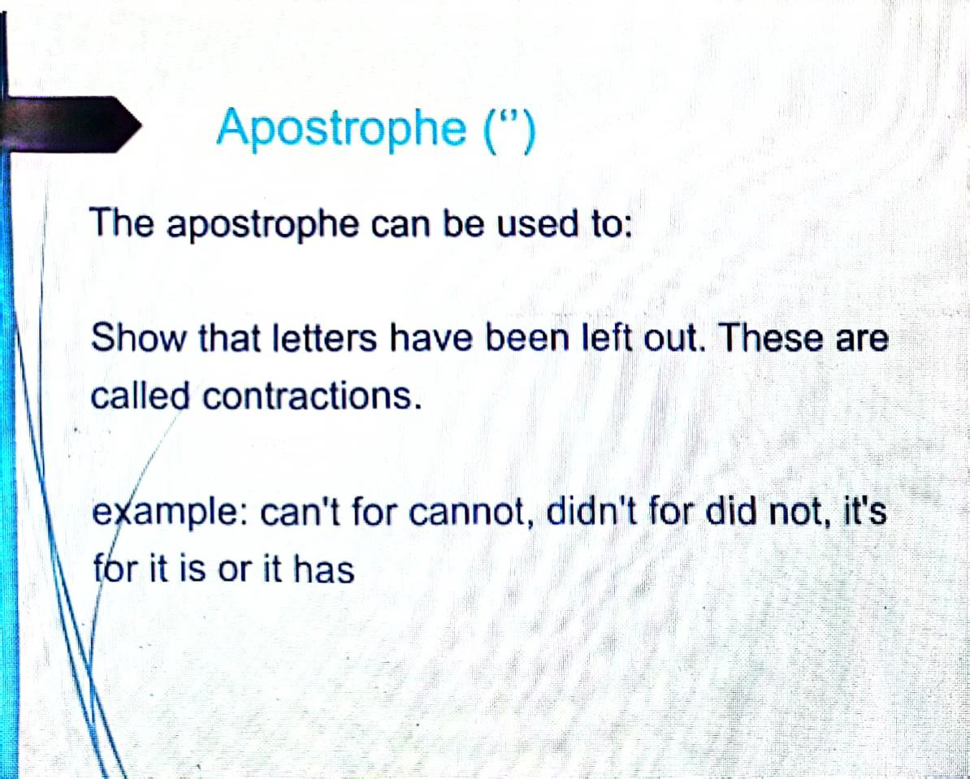

Slide 36
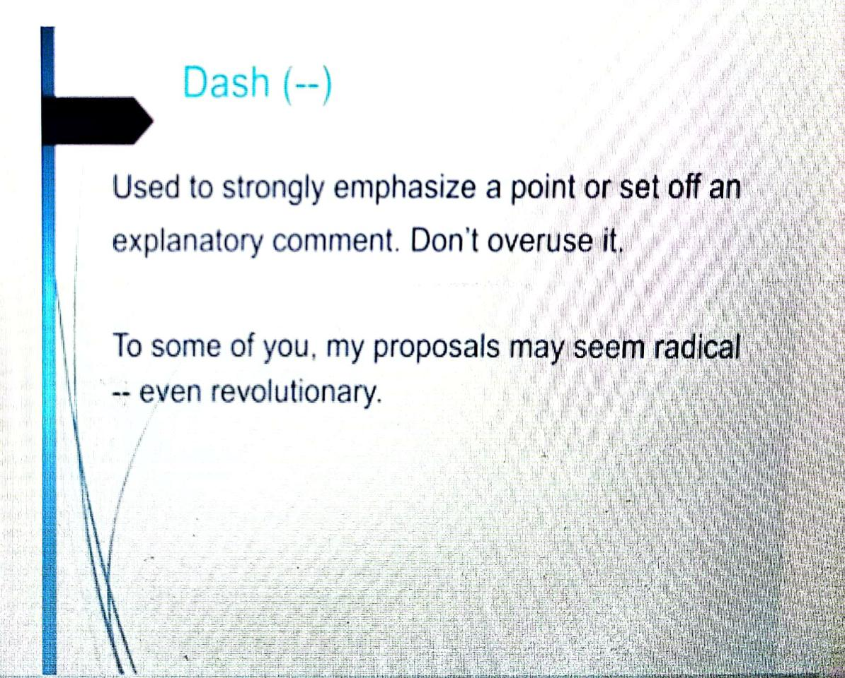

Slide 37
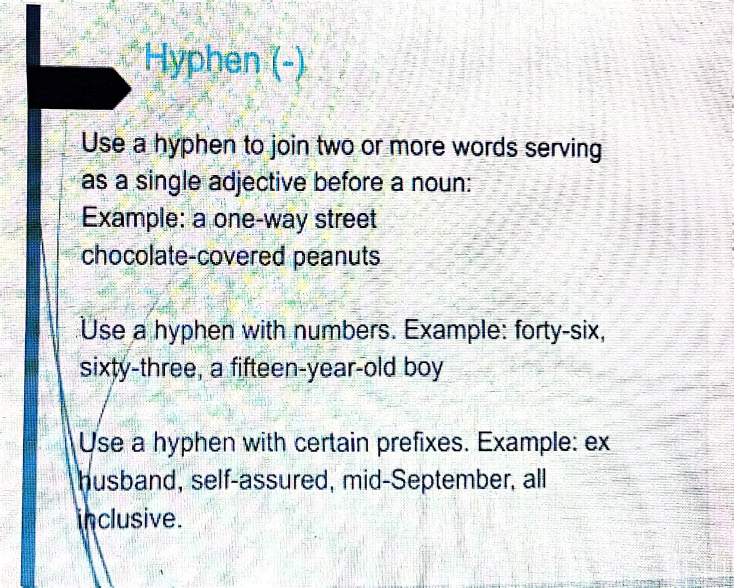

Slide 38
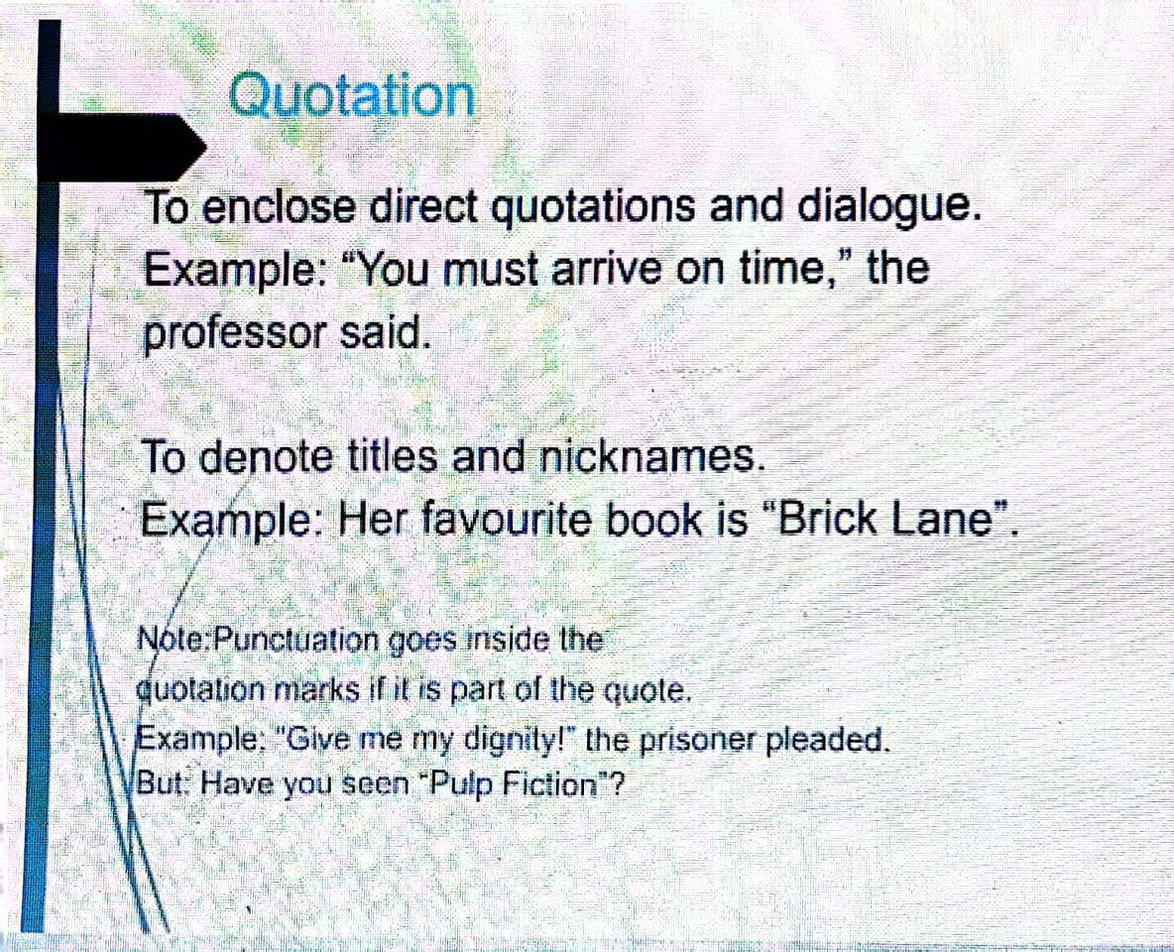

Slide 39
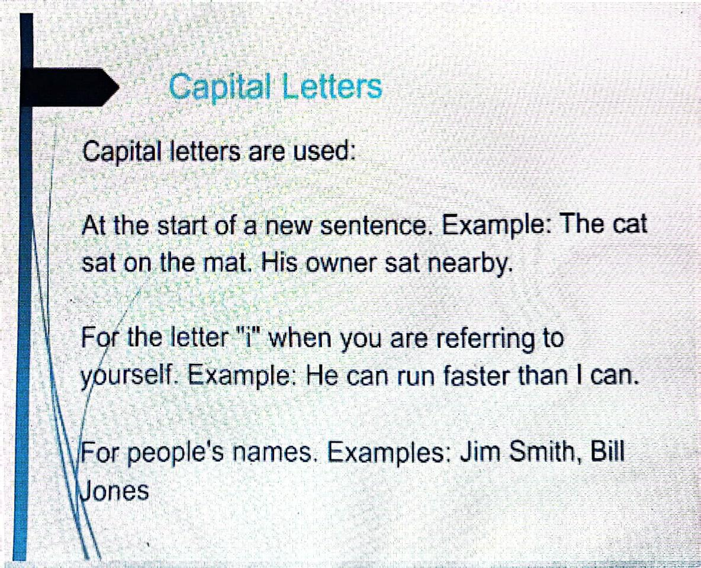

Slide 40
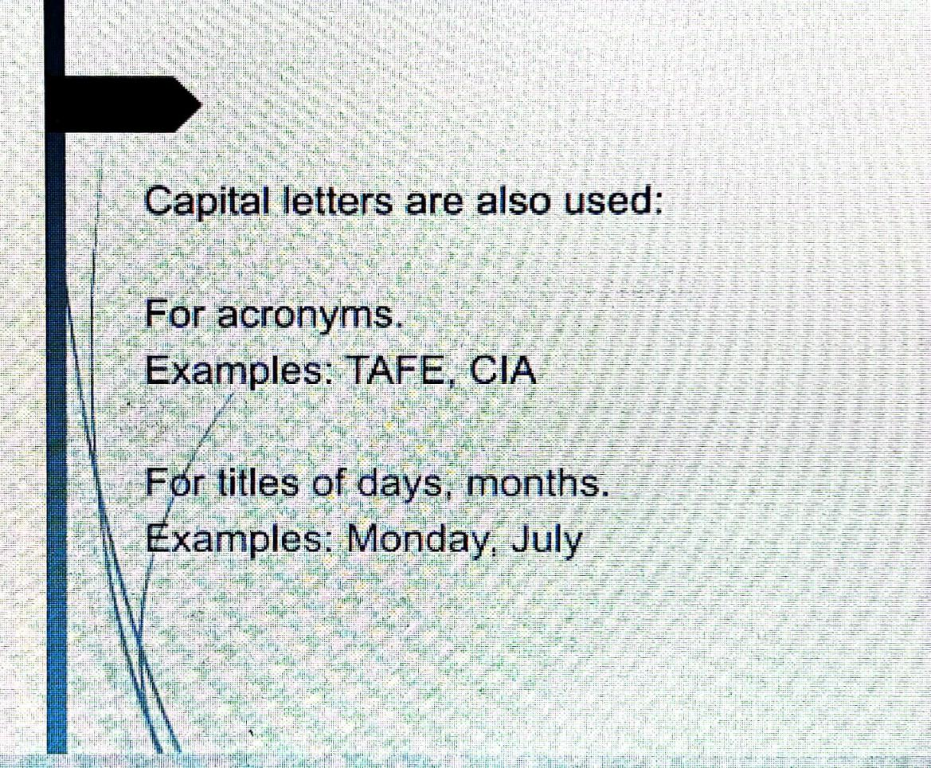
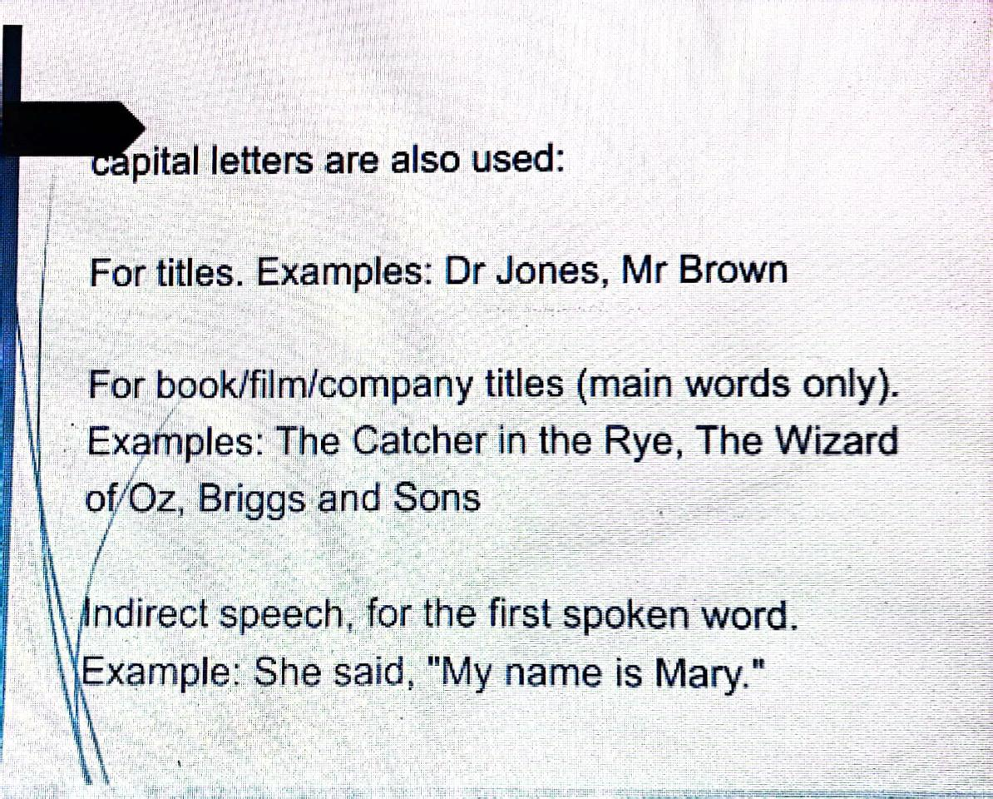

Slide 41
Use appropriate punctuation marks in the following sentences.
1. We had a great time in France the kids really enjoyed it 2. Some people work best in the mornings others do better in the evenings 3. What are you doing next weekend 4. Mother had to go into hospital she had heart problems 5. Did you understand why I was upset 6. It is a fine idea let us hope that it is going to work 7. We will be arriving on Monday morning at least I think so 8. A textbook can be a wall between teacher and class 9. The girls father sat in a corner 10. In the words of Murphys Law Anything that can go wrong will go wrong

Slide 42
Answers
1. We had a great time in France – the kids really enjoyed it. 2. Some people work best in the mornings; others do better in the evenings. 3. What are you doing next weekend? 4. Mother had to go into hospital: she had heart problems. 5. Did you understand why I was upset? 6. It is a fine idea; let us hope that it is going to work. 7. We will be arriving on Monday morning – at least, I think so. 8. A textbook can be a ‘wall’ between teacher and class. 9. The girl’s father sat in a corner. 10. In the words of Murphy’s Law: ‘Anything that can go wrong will go wrong.’

Slide 43
CONJUNCTION OR CONNECTIVES
The Common Core State Standards (CCSS) require students to use language cohesively and to be able to develop different methods of linking paragraphs in oral and written language.
To do so, it is imperative students learn appropriate use of
conjunctions and connectives since both have similar grammar functions.
A conjunction normally connects two sentences, while connectives are used as connecting words within a sentence.
They are generally used to indicate different purposes, such as addition, sequence, consequence and/or contrast. They are also used to indicate reason and time.

Slide 44
USE OF CONNECTIVES
Connectives can be one word or a phrase.
The purpose of the words or ideas to be connected will determine the type of connective used.
Connectives can be also used as starters of a paragraph or clause, whereas conjunctions generally cannot.

Slide 45
BASIC RULES FOR USING CONNECTIVES
The different types of connectives are not interchangeable.
The sentences/ideas being connected must be related.
Connectives are usually used only once in a sentence.

Slide 46
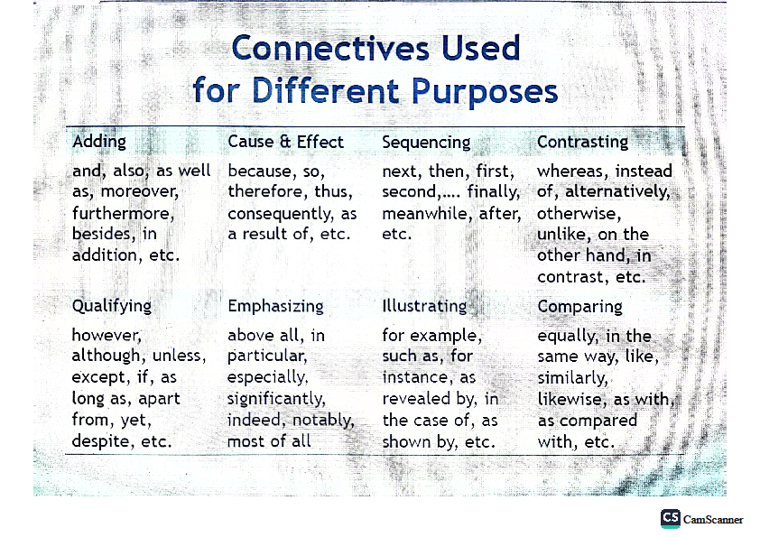

Slide 47
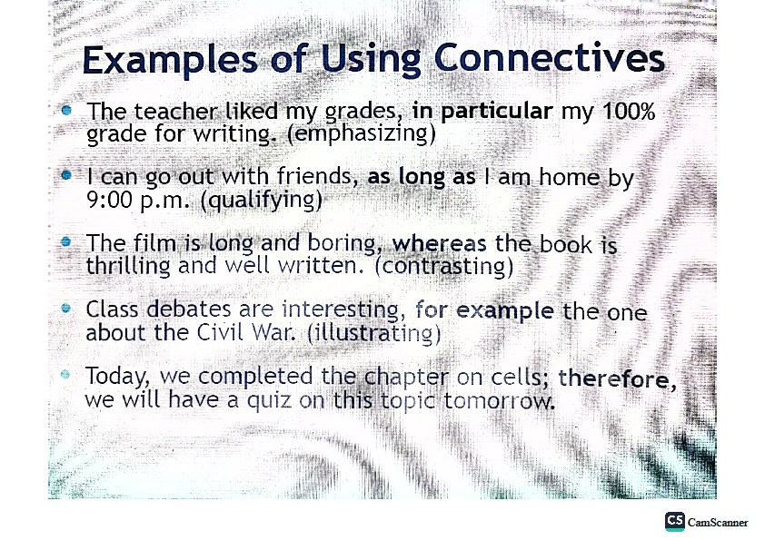

Slide 48
Activity #1
Complete the blanks with the appropriate connective from the list at the bottom:
1. I put a note beside his cereal bowl; ________, he would not
notice it.
2. She married him _________ he was extremely rich.
3. You should study more, _________ you might fail your exams.
4. Sarah was not smiling. _____________, Sarah was already
lonely.
5. I will go for a walk if the weather is nice; ________, you can
ride your bike.
(since, because, furthermore, otherwise, likewise)

Slide 49
Answers:
Since
Because
3.Otherwise
4.Furthermore
5.Likewise

Slide 50
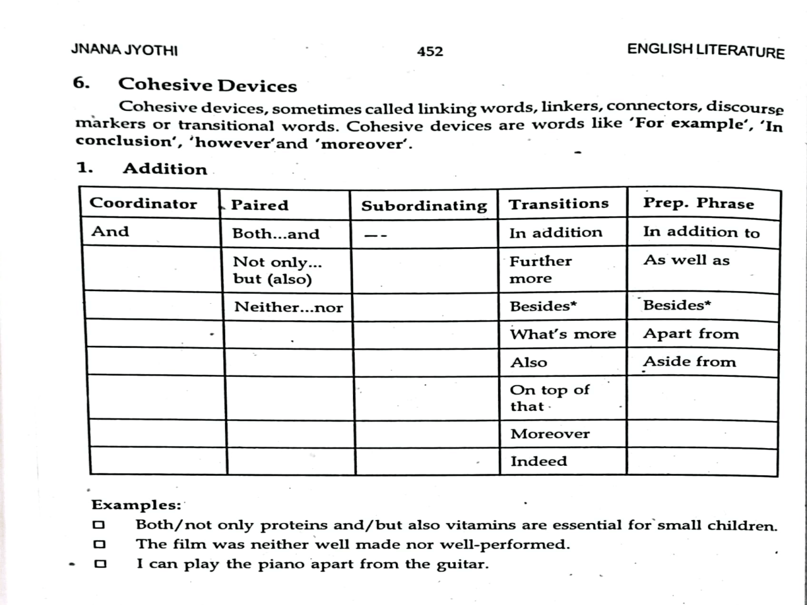

Slide 51
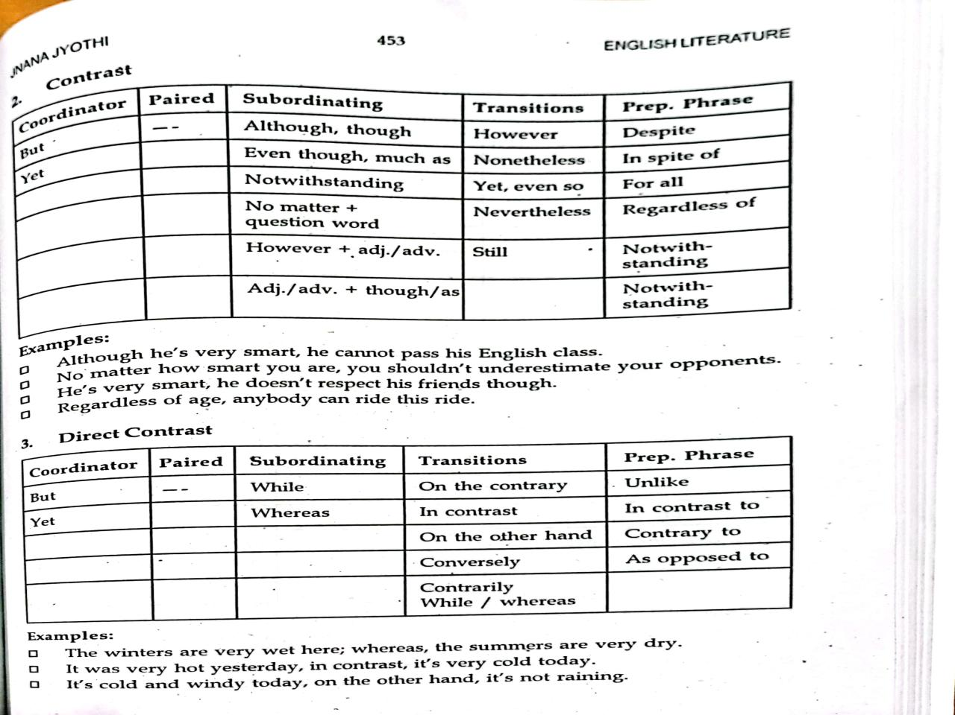

Slide 54
Precise/ Précis writing

Slide 55
PRÉCIS WRITING
Why do we need ‘Précis Writing’?
Academic writing as different from creative writing, demands specific writing skills. Of course, it is understood that writing skills do not exist independently of reading skills. Précis writing hones both academic reading and writing skills.
Précis writing demands careful reading, critical thinking, recognizing repetition, and editing.
Writing précis of a given passage demands that the reader follow important steps before writing. It is an exacting exercise.

Slide 56
A Note on Précis Writing
Précis is a French word that means ‘Precise’. The shortening of a longer text in one’s own words is known as Précis Writing. Précis is an accurate and concise description of the main idea of the text, to be written without changing the meaning of the text. In fact, it is an exact reproduction of the logic, organization, and emphasis of the original text.
It is a very useful exercise as it:
Inculcates careful reading habits.
Develops our capacity to discriminate between the essential and the non-essential.
Insists on an economy of words.
Teaches one to choose words carefully.
Helps to construct sentences in a concise manner.
In short, it is a miniature version of the original passage.

Slide 57
Difference between Précis and Summary
Usually, ‘summarising’ is used synonymously with précis writing. There are differences between them. The differences are listed below:
1. Précis is made from a report, article or a chapter; whereas summary is an outline of the longer writing such as a novel, a poem, a research thesis etc.
2. Précis has to follow the order and proportion of the material in the original. In a summary, on the other hand, the writer is free to change the order and proportion if required.
3. The most significant difference is that précis states the thoughts/idea of the original text; a summary could include analysis, interpretation and/or comment on it.

Slide 58
Steps to Write a Précis
1. Read the given text carefully and understand the main argument or idea. Identify the main idea of the text.
2. Differentiate the main idea from the subordinate idea; also, recognise which are the essential subordinate ideas that support the main idea.
3. From your careful reading of the text, provide a short, suitable title to the Précis.
4. First, make a rough draft of the text by removing repeated ideas, examples and non essential details. The draft has to be exactly one-third of the text.
5.Re-read the draft to ensure that the main point, supporting ideas and the argument is the same as the text. Also, check to ensure that the order of the original text is maintained. If required, edit the draft once again.
6. Now, make a second draft, ensuring that the order and the meaning of the text have not changed.

Slide 59
Passage
There is an enemy beneath our feet - an enemy more deadly for his complete impartiality. He recognizes no national boundaries, no political parties. Everyone in the world is threatened by him. The enemy is the earth itself. When an earthquake strikes, the world trembles. The power of a quake is greater than anything man himself can produce. But today scientists are directing a great deal of their effort into finding some way of combating earthquakes, and it is possible that at some time in the near future mankind will have discovered a means of protecting itself from earthquakes. An earthquake strikes without warning. When it does, its power is immense. If it strikes a modern city, the damage it causes is as great as if it has struck a primitive village. Gas mains burst, explosions are caused and fires are started. Underground railways are wrecked. Buildings collapse, bridges fall, dams burst, gaping crevices appear in busy streets. If the quake strikes at sea, huge tidal waves sweep inland. If it strikes in mountain regions, avalanches roar down into the valley. Consider the terrifying statistics from the past 1755: Lisbon, capital of Portugal - the city destroyed entirely and 450 killed. 1970: Peru: 50,000 killed. In 1968 an earthquake struck Alaska. As this is a relatively unpopulated part, only a few people were killed. But it is likely that this was one of the most powerful quakes ever to have hit the world. Geologists estimate that during the tremors, the whole of the state moved over 80 feet farther west into the Pacific Ocean. Imagine the power of something that can move an entire subcontinent!

Slide 60
Essay writing

Slide 61
FORMAT OF ESSAY WRITING
Topic:__________________________________ Introduction: Opening sentence about the topic should write. ------------------------------------------------------------------- Meaning and definition: Write meaning and definition of the topic.----------------------------- ------------------------------------------------------------------------------------------------------ 3. Explanation: Write the topic sentence, supporting sentences, and closing sentence.____________________ Write clear and simple sentences to express your meaning.____________________________ Focus on the main idea of your paragraph._________________________________________ Use proverbs, motto, and statements pertaining to the topic. ------------------------------------------------------------------------------------------------------------------------------ 4. Conclusion: -------------------------------------------------------------- 1.Write your own opinion and criticize about the related topic. 2. Write recommendations, suggestions, advise about the related topic. -------------------------------------------------------------------

Slide 62
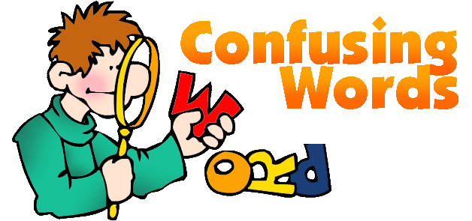

Slide 63
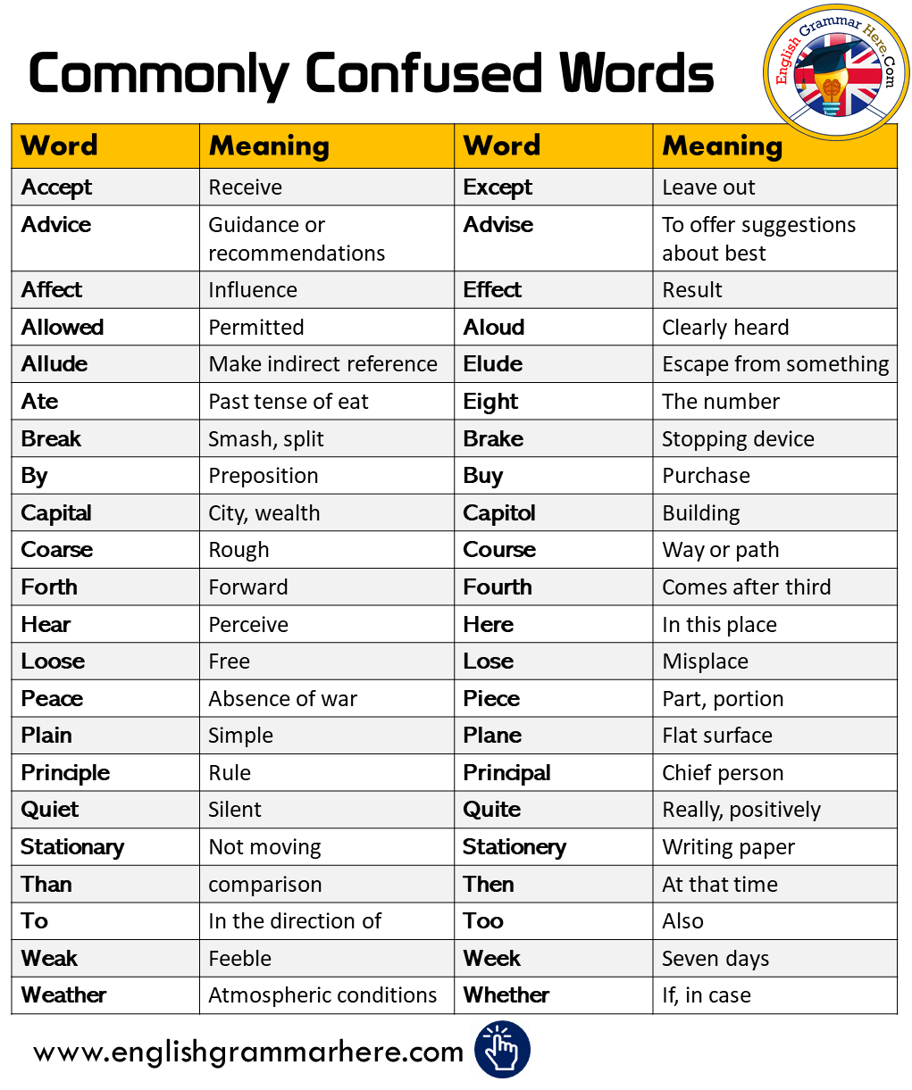

Slide 64
Fill the blanks with appropriate words from the bracket.
1. Everyone hates being ___________, for his or her mistakes. (Censure/censor)
2. By helping anyone who has committed a crime, we are indirectly being an _________ to the crime. (Accessary/ accessory)
3. The sentence of death passed on the two murders wasn’t ___________ right, according to me. (Quiet, quite)
4. It is believed that the __________ of Nero was one of our ever increasing populations. (Reign, rein)

Slide 65
